Slide 1
Biochemistry
Lec:6
Dr.Radhwan M. Asal
Bsc. Pharmacy
MSC ,PhD Clinical Biochemistry

Slide 2
Enzymes
Virtually all reactions in the body are mediated by enzymes, which are protein catalysts that increase the rate of reactions without being changed in the overall process.
NOMENCLATURE
Each enzyme is assigned two names. The first is its short, recommended name, convenient for everyday use. The second is the more complete systematic name, which is used when an enzyme must be identified without ambiguity.

Slide 3
A. Recommended name
Most commonly used enzyme names have the suffix "-ase" attached to the substrate of the reaction (for example, glucosidase ,urease), or to a description of the action performed (for example, lactate dehydrogenase and adenylyl cyclase). [Note: Some enzymes retain their original trivial names, which give no hint of the associated enzymic reaction, for example, trypsin and pepsin.]
B. Systematic name
Enzymes are divided into six major classes , each with numerous subgroups. The suffix -ase is attached to a fairly complete description of the chemical reaction catalyzed. The names are unambiguous and informative, but are sometimes too cumbersome to be of general use.

Slide 4
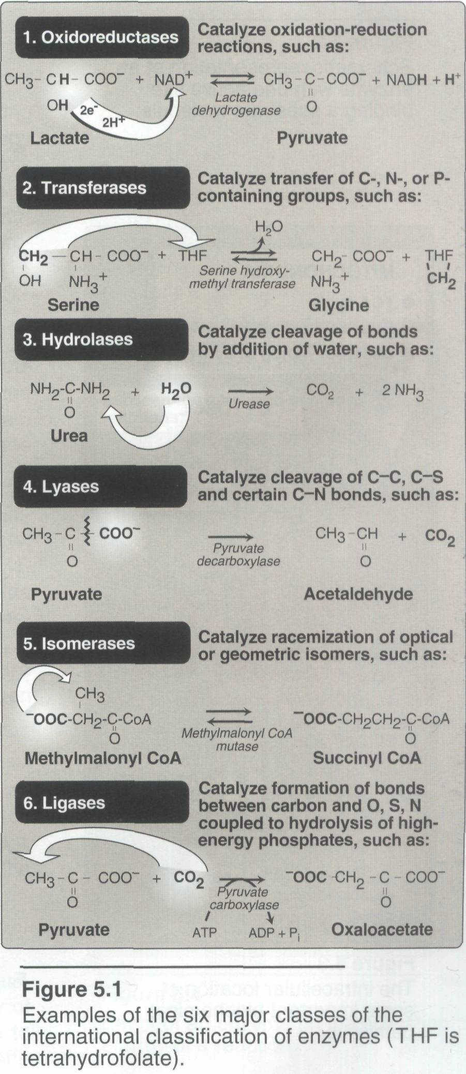
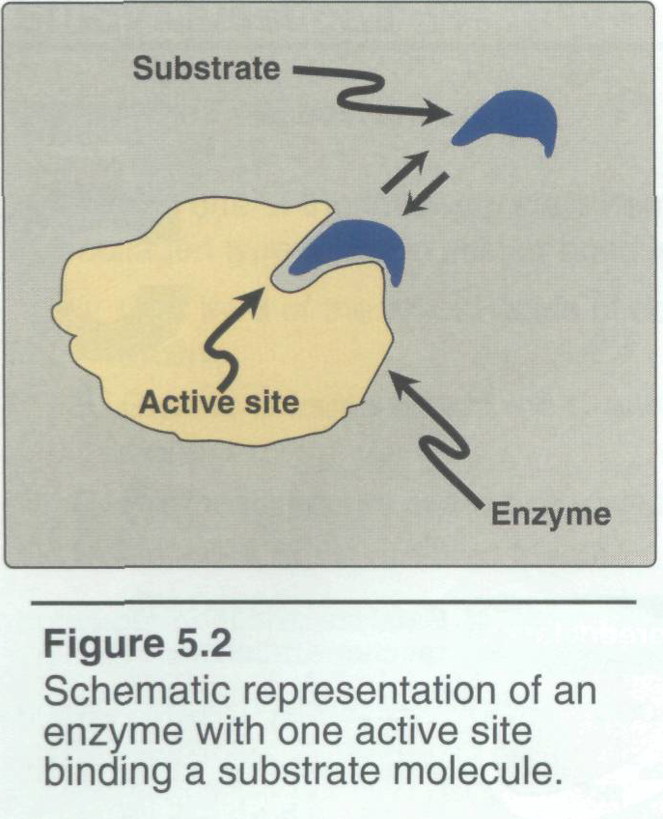

Slide 5
Properties of enzymes
Enzymes are catalysts that increase the velocity of a chemical reaction, and are not consumed. Some types of RNA can act like enzymes, usually catalyzing the cleavage and synthesis of phosphodiester bonds. RNAs with catalytic activity are called ribozyme.
Active sites
Enzyme molecules contain a special pocket or cleft called the active site. The active site contains amino acid side chains that create a three-dimensional surface complementary to the substrate . The active site binds the substrate, forming an enzyme-substrate (ES) complex. ES is converted to enzyme-product (EP), which subsequently dissociates to enzyme and product.

Slide 6
Catalytic efficiency
Most enzyme-catalyzed reactions are highly efficient, proceeding from 10³ to 10⁸ times faster than uncatalyzed reactions. Typically, each enzyme molecule is capable of transforming 100 to 1000 substrate molecules into product each second. The number of molecules of substrate converted to product per enzyme molecule per second is called the turnover number.
Specificity
Enzymes are highly specific, interacting with one or a few substrates and catalyzing only one type of chemical reaction.

Slide 7
Cofactors
Some enzymes associate with a nonprotein cofactor that is needed for
enzymatic activity. Commonly encountered cofactors include metal ions such as Zn ²⁺ and Fe ²⁺ and organic molecules, known as coenzymes, that are often derivatives of vitamins. For example, the coenzyme NAD+ contains niacin, FAD+ contains riboflavin, and coenzyme A contains pantothenic acid. Holoenzyme refers to the enzyme with its cofactor. Apoenzyme refers to the protein portion of the holoenzyme. In the absence of the appropriate cofactor, the apoenzyme typically does not show biologic activity. A prosthetic group is a tightly bound coenzyme that does not dissociate from the enzyme.
.

Slide 8
Location within the cell
Many enzymes are localized in specific organelles within the cell . Such compartmentalization serves to isolate the reaction substrate or product from other competing reactions.

Slide 10

How enzymes work
The mechanism of enzyme action can be viewed from two different perspectives.
A. Energy changes occurring during the reaction
Virtually all chemical reactions have an energy barrier separating the reactants and the products. This barrier, called the free energy of activation, is the energy difference between that of the reactants and a high-energy intermediate that occurs during the formation of product.

Slide 11
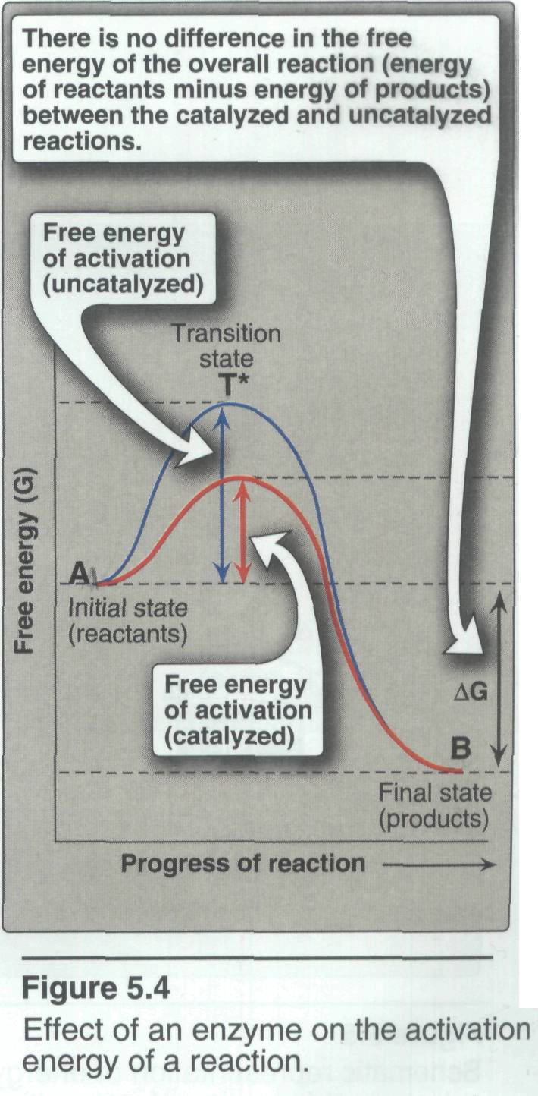
Free energy of activation: The peak of energy is the difference in free energy between the reactant and T*, where the high-energy intermediate is formed during the conversion of reactant to product. Because of the high free energy of activation, the rates of uncatalyzed chemical reactions are often slow.

Slide 12
Rate of reaction: For molecules to react, they must contain sufficient energy to overcome the energy barrier of the transition state. In the absence of an enzyme, only a small proportion of a population of molecules may possess enough energy to achieve the transition state. In general, the lower the free energy of activation, the more molecules have sufficient energy to pass through the transition state, and, thus, the faster the rate of the reaction.
Alternate reaction pathway: An enzyme allows a reaction to proceed rapidly by providing an alternate reaction pathway with a lower free energy of activation . The enzyme does not change the free energies of the reactants or products and, therefore, does not change the equilibrium of the reaction.

Slide 13
B. Chemistry of the active site
The active site is not a passive receptacle for binding the substrate, but rather is a complex molecular machine employing a diversity of chemical mechanisms to facilitate the conversion of substrate to product. A number of factors are responsible for the catalytic efficiency of enzymes, including the following:
Transition-state stabilization: The active site often acts as a flexible molecular template that binds the substrate in a geometric structure resembling the activated transition state of the molecule. By stabilizing the substrate in its transition state, the enzyme greatly increases the concentration of the reactive intermediate that can be converted to product and, thus, accelerates the reaction.

Slide 14
Other mechanisms: The active site can provide catalytic groups that enhance the probability that the transition state is formed. In some enzymes, these groups can participate in general acid-base catalysis in which amino acid residues provide or accept protons. In other enzymes, catalysis may involve the transient formation of a covalent enzyme-substrate complex.
Factors affecting reaction velocity
A.Substrate concentration
Maximal velocity: The rate or velocity of a reaction (v) is the number of substrate molecules converted to product per unit time; velocity is usually expressed as micro mole of product formed per minute.

Slide 15
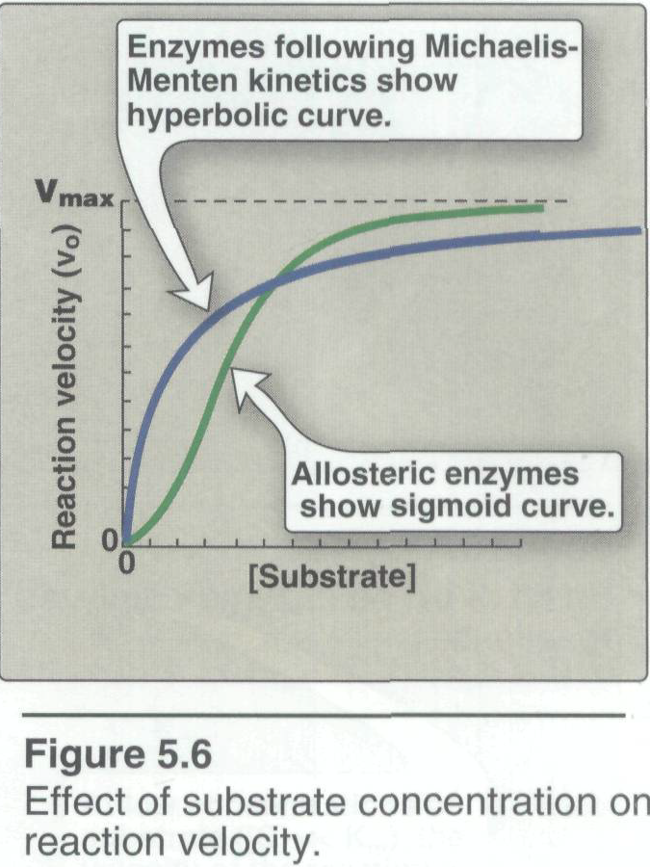
The rate of an enzyme-catalyzed reaction increases with substrate concentration until a maximal velocity (Vmax) is reached . The leveling off of the reaction rate at high substrate concentrations reflects the saturation with substrate of all available binding sites on the enzyme molecules present.

Slide 16
Hyperbolic shape of the enzyme kinetics curve: Most enzymes show Michaelis-Menten kinetics , in which the plot of initial reaction velocity Vo, against substrate concentration [S], is hyperbolic similar in shape to that of the oxygen-dissociation curve of myoglobin. In contrast, allosteric enzymes frequently show a sigmoidal curve that is similar in shape to the oxygen-dissociation curve of hemoglobin.
B. Temperature
Increase of velocity with temperature: The reaction velocity increases with temperature until a peak velocity is reached . This increase is the result of the increased number of molecules having sufficient energy to pass over the energy barrier and form the products of the reaction.

Slide 17
Decrease of velocity with higher temperature: Further elevation of the temperature results in a decrease in reaction velocity as a result of temperature-induced denaturation of the enzyme.
C. pH
1. Effect of PH on the ionization of the active site: The concentration of H + affects reaction velocity in several ways.

Slide 18
the catalytic process usually requires that the enzyme and substrate have specific chemical groups in either an ionized or unionized state in order to interact. For example, catalytic activity may require that an amino group of the enzyme be in the protonated form –NH3+.At alkaline PH this group is deprotonated, and the rate of the reaction, therefore, declines.
2. Effect of pH on enzyme denaturation: Extremes of PH can also lead to denaturation of the enzyme, because the structure of the catalytically active protein molecule depends on the ionic character of the amino acid side chains.

Slide 19
3. The pH optimum varies for different enzymes: The PH at which maximal enzyme activity is achieved is different for different enzymes, and often reflects the (H+) at which the enzyme functions in the body. For example, pepsin, a digestive enzyme in the stomach, is maximally active at PH 2, whereas other enzymes, designed to work at neutral pH, are denatured by such an acidic environment.

