Slide 1
Biochemistry
Lec:7
Dr.Radhwan M. Asal
Bsc. Pharmacy
MSC ,PhD Clinical Biochemistry

Slide 2
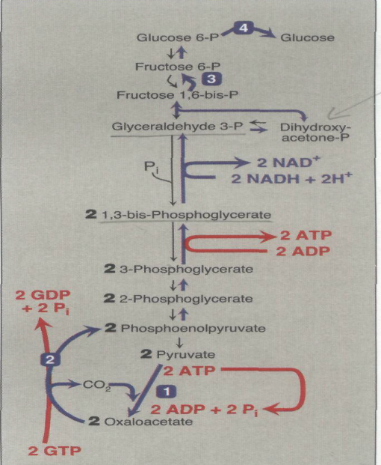
Gluconeogenesis
SUBSTRATES FOR GLUCONEOGENESIS
Gluconeogenic precursors are molecules that can be used to produce a net synthesis of glucose. They include all the intermediates of glycolysis and the citric acid cycle. Glycerol, lactate, and the α-keto acids obtained from the deamination of glucogenic amino acids are the most important gluconeogenic precursors.

Slide 3
Glycerol:
is released during the hydrolysis of triacylglycerol in adipose tissue, and is delivered by the blood to the liver. Glycerol is phosphorylated by glycerol kinase to glycerol phosphate, which is oxidized by glycerol phosphate dehydrogenase to dihydroxyacetone phosphate an intermediate of glycolysis. [Note: Adipocytes cannot phosphorylate glycerol because they lack glycerol kinase.]

Slide 4
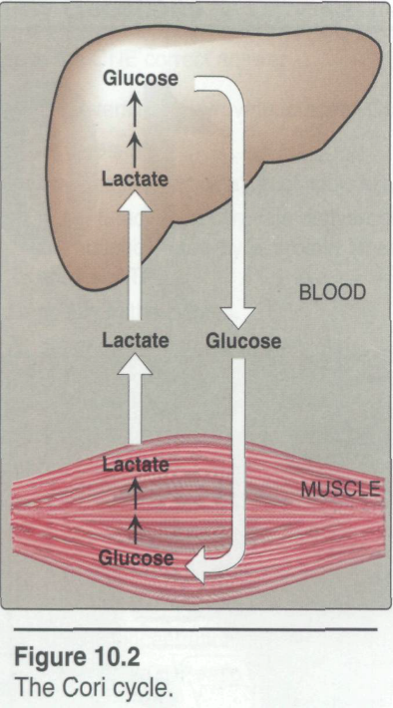
B. Lactate : is released into the blood by exercising skeletal muscle, and by cells that lack mitochondria, such as red blood cells. In the Cori cycle, blood-borne glucose is converted by exercising muscle to lactate, which diffuses into the blood. This lactate is taken up by the liver and reconverted to glucose, which is released back into the circulation

Slide 5
C. Amino acids : Amino acids derived from hydrolysis of tissue proteins are the major sources of glucose during a fast. α-ketoacid such as oxaloacetate and α-ketoglutarate, are derived from the metabolism of glucogenic amino acids ( These substances can enter the citric acid cycle and form oxaloacetate direct precursor of phosphoenolpyruvate. [Note: Acetyl CoA and compounds that give rise to acetyl CoA (for example, acetoacetate and amino acids such as lysine and leucine) cannot give rise to a net synthesis of glucose. This is due to the irreversible nature of the pyruvate dehydrogenase reaction, which converts pyruvate to acetyl CoA .These compounds give rise instead to ketone bodies and are therefore termed ketogenic]

Slide 6
Seven glycolytic reactions are reversible and are used in the synthesis of glucose from lactate or pyruvate. However, three of the reactions are irreversible and must be circumvented by four alternate reactions that energetically favor the synthesis of glucose. These reactions, unique to gluconeogenesis
A. Carboxylation of pyruvate
The first "roadblock" to overcome in the synthesis of glucose from pyruvate is the irreversible conversion in glycolysis of pyruvate to phosphoenolpyruvate (PEP) by pyruvate kinase. In gluconeogenesis, pyruvate is first carboxylated by pyruvate carboxylase to oxaloacetate (OAA), which is then converted to PEP by the action of PEP carboxykinase .

Slide 7
B. Transport of oxaloacetate to the cytosol
Oxaloacetate, formed in the mitochondria, must enter the cytosol where the other enzymes of gluconeogenesis are located. However, OAA is unable to directly cross the inner mitochondrial membrane; it must first be reduced to malate by mitochondrial malate dehydrogenase. Malate can be transported from the mitochondria to the cytosol, where it is reoxidized to oxaloacetate by cytosolic malate dehydrogenase

Slide 8
C. Decarboxylation of cytosolic oxaloacetate
Oxaloacetate is decarboxylated and phosphorylated in the cytosol by PEP-carboxykinase (also referred to as PEP CK) The reaction is driven by hydrolysis of GTP .The combined actions of pyruvate carboxylase and PEP-carboxykinase provide an energetically favorable pathway from pyruvate to PEP. PEP is then acted on by the reactions of glycolysis running in the reverse direction until it becomes fructose 1,6 bisphosphate.

Slide 9
D. Dephosphorylation of fructose
Hydrolysis of fructose 1,6bisphosphate by fructose 1,6 bisphatase bypasses the irreversible phosphofructokinase reaction, and provides an energetically favorable pathway for the formation of fructose 6-phosphate . This reaction is an important regulatory site of gluconeogenesis.
E. Dephosphorylation of glucose 6-phosphate
Hydrolysis of glucose 6-phosphate by glucose 6-phosphatase bypasses the irreversible hexokinase reaction, and provides an energetically favorable pathway for the formation of free glucose.

Slide 10
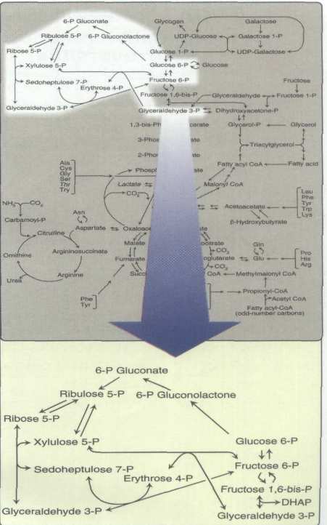
Pentose phosphate pathway The pentose phosphate pathway (also called the hexose monophosphate shunt, or 6-phosphogluconate pathway) occurs in the cytosol of the cell. It consists of two, irreversible oxidative reactions, followed by a series of reversible sugar-phosphate interconversions .

Slide 11
No ATP is directly consumed or produced in the cycle. Carbon one of glucose 6-phosphate is released as CO2 and two NADPH are produced for each glucose 6-phosphate molecule entering the oxidative part of the pathway.
The rate and direction of the reversible reactions of the pentose phosphate pathway are determined by the supply of and demand for intermediates of the cycle. The pathway provides a major portion of the body's NADPH, which functions as a biochemical reductant. also produces ribose 5-phosphate required for the biosynthesis of nucleotides ,and provides a mechanism for the metabolic use of five-carbon sugars obtained from the diet or the degradation of structural carbohydrates in the body.

Slide 12
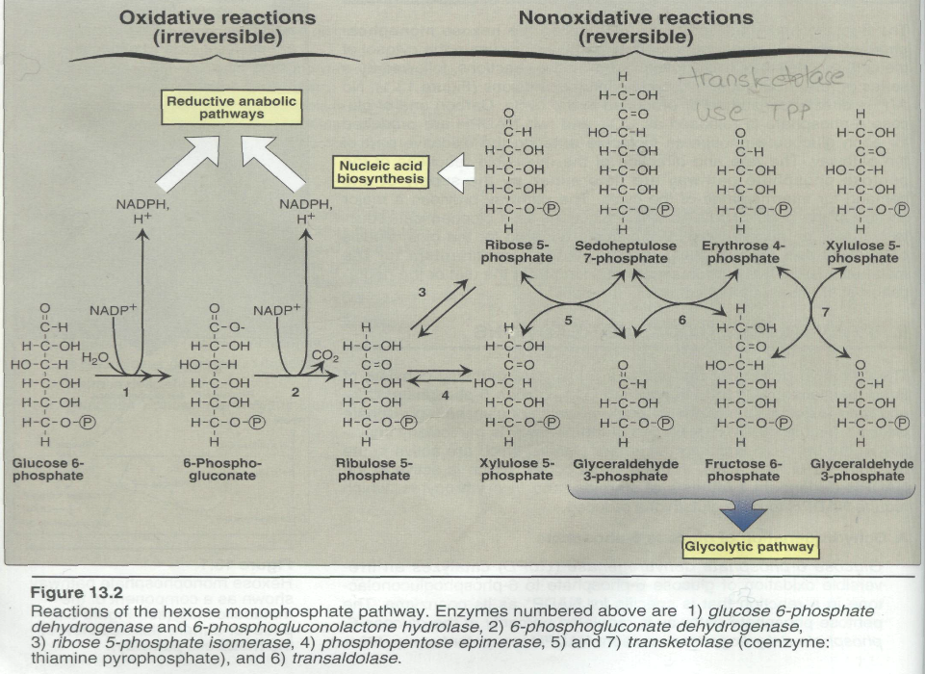

Slide 13
IRREVERSIBLE OXIDATIVE REACTIONS
The oxidative portion of the pentose phosphate pathway consists of three reactions that lead to the formation of ribulose 5-phosphate,CO2, and two molecules of NADPH for each molecule of glucose 6-phosphate oxidized. This portion of the pathway is particularly important in the liver and lactating mammary glands, which are active in the biosynthesis of fatty acids, in the adrenal cortex, which is active in the NADPH-dependent synthesis of steroids, and in erythrocytes, which require NADPH to keep glutathione reduced.

Slide 14
A. Dehydrogenation of glucose 6-phosphate
Glucose 6-phosphate dehydrogenase (G6PD) catalyzes an irreversible oxidation of glucose 6-phosphate to 6-phosphoglucanolactone in a reaction that is specific for NADP+ as its coenzyme. The pentose phosphate pathway is regulated primarily at the glucose 6phosphate dehydrogenase reaction. NADPH is a potent competitive inhibitor of the enzyme, and, under most metabolic conditions, the ratio of NADPH/NADP+ is sufficiently high to substantially inhibit enzyme activity. However, with increased demand for NADPH, the ratio of NADPH/NADP+ ratio decreases and flux through the cycle increases in response to the enhanced activity of glucose 6-phos-phate dehydrogenase..

Slide 15
Insulin enhances G6PD gene expression, and flux through the pathway increases in the well-fed state
B. Formation of ribulose 5-phosphate
6-phosphoglucanolactone is hydrolyzed by 6-phosphoglucanolactone hydrolase. The reaction is irreversible and not rate-limiting. The subsequent oxidative decarboxylation of 6-phosphogluconate catalyzed by 6-phosphogluconate dehydrogenase. This irreversible reaction produces a pentose sugar-phosphate (ribulose 5-phosphate),CO2 (from carbon 1 of glucose), and a second molecule of NADPH .

Slide 16
REVERSIBLE NONOXIDATIVE REACTIONS
The nonoxidative reactions of the pentose phosphate pathway occur in all cell types synthesizing nucleotides and nucleic acids. These reactions catalyze the interconversion of three-, four-, five-, six-, and seven-carbon sugars .These reversible reactions permit ribulose 5-phosphate (produced by the oxidative portion of the pathway) to be converted either to ribose 5-phosphate (needed for nucleotide synthesis) or to intermediates of glycolysis fructose 6- phosphate and glyceraldehyde 3-phosphate.

Slide 17
For example, many cells that carry out reductive biosynthetic reactions have a greater need for NADPH than for ribose 5-phosphate. In this case, transketolase (which transfers two-carbon units) and transaldolase (which transfers three-carbon units) convert the ribulose 5-phosphate produced as an end-product of the oxidative reactions to glyceraldehyde 3-phosphate and fructose 6-phosphate, which are intermediates of glycolysis. In contrast, under conditions in which the demand for ribose for incorporation into nucleotides and nucleic acids is greater than the need for NADPH, the nonoxidative reactions can provide the biosynthesis of ribose 5-phos-phate from glyceraldehyde 3-phosphate and fructose 6-phosphate in the absence of the oxidative steps

Slide 18
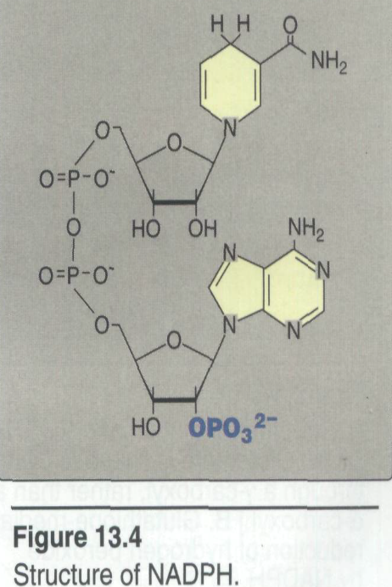
USES OF NADPH
The coenzyme NADP+ differ from the NAD+ only by the presence of a phosphate group -PO4⁼ on one of the ribose units:

Slide 19
A. Reductive biosynthesis
NADPH can be thought of as a high-energy molecule, much in the same way as NADH. However, the electrons of NADPH are destined for use in reductive biosynthesis, rather than for transfer to oxygen as is the case with NADH .Thus, in the metabolic transformations of the pentose phosphate pathway, part of the energy of glucose 6-phosphate is conserved in NADPH in molecule that can be used in reactions requiring a high electron-potential electron donor.

Slide 20
B. Reduction of hydrogen peroxide
Hydrogen peroxide is one of a family of reactive oxygen species that are formed from the partial reduction of molecular oxygen .
These compounds are formed continuously as by-products of aerobic metabolism, through reactions with drugs and environmental toxins, or when the level of antioxidants is diminished, all creating the condition of oxidative stress. The highly reactive oxygen intermediates can cause serious chemical damage to DNA, proteins, and unsaturated lipids, and can lead to cell death. These reactive oxygen species have been implicated in a number of pathologic processes, including reperfusion injury, cancer, inflammatory disease, and aging.

Slide 21
Thank You

