Slide 1
Prepared by Yussor noory Physical pharmacy college of Pharmacy Lab5
Solubilization by Surfactants

Slide 2
Solubilization :- is defined as a particular mode of brining into solution substances that are other wise insoluble in a given medium , involving the previous presence of colloidal solution whose particles take up and incorporate within or upon them selves the other wise insoluble material .
Surfactants are amphiphilic molecules, consisting of both hydrophilic and hydrophobic regions. These substances are known to play a vital role in many processes of interest in both fundamental and applied sciences. One important property of surfactants is the formation of colloidal-sized clusters in solutions, known as micelles, which have particular significance in Pharmacy because of their ability to increase the solubility of sparingly soluble substances in water . The ambivalence of amphiphiles towards an aqueous environment is responsible for the phenomenon of self-association of individual surfactant molecules resulting in a variety of micellar aggregate structures .

Slide 3
The concentration of a monomeric amphiphile (surfactant molecule) at which micelles appear is called the Critical Micelle Concentration (CMC). The occurrence of a CMC results from a delicate balance of intermolecular forces. Micelles are formed at the critical micelle concentration (CMC), which is detected as an inflection point when physicochemical properties such as surface tension are plotted mas a function of concentration . The main reason for micelle formation is the attainment of a minimum free energy state. The main driving force for the formation of micelles is the increase of entropy that occurs when the hydrophobic regions of the surfactant are removed from water and the ordered structure of the water molecules around this region of the molecule is lost. Most micelles are spherical and contain between 60 and 100 surfactant molecules.

Slide 4
In a micelle , polar or ionic heads form an outer shell in contact with water ,while non-poler tails are sequestered in the interior to avoid water and obtain minimum energy state . The typical micelle diameter is about 2-3 nm , therefore they are not visible under the light microscope .
Micelle can increase the solubility of slightly soluble drugs by incorporating them into the hydrophobic core of the micelle solubilization does not occur until the micelle are formed (i.e. surfactant concentration must be above C.M.C ). The amount of substance solubilized increases as the number of micelle increases .

Slide 5
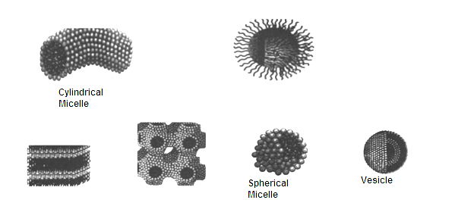
Shape of micelle 1-Spherical micelle 2- Laminar micelle 3- Cylindrical micelle
Laminar micelle
The physical properties of solution containing surface active agents are change ,
at C.M.C serface tension , conductivity , and osmotic pressure .

Slide 6
Experimental work
The aim of this experiment is to observe the effect of increasing the concentration of Tween 80 on the solubility of salicylic acid

Slide 7
Procedure:
1- prepare 6 solution of (0.25g) of salicylic acid in 25 ml of different concentrations of Tween 80 (0%,1%,2%,4%, 6%, and 10%)
2- shake the flasks for 10 minutes then filter
3- Titrate 10 ml of the filtrate NaOH solution (0.05)using phenol red as indicator . The end point is determined when the colour changes from yellow to pink
4- plot the solubility (w/v%) of salicylic acid against concentration (w/v%) of tween 80 .

Slide 8
Calculation:
(NaOH) (Salicylic Acid)
N x V = N x V
(0.05) x = (N(S.A)) x 10
N x V = Wt Salicylic acid / Eq.Wt Salicylic acid
0.05 x 0.001 = Wt Salicylic acid/138.1
Wt Salicylic acid = 0.0069 mg (Chemical factor)
Chemical factor x end point = g (mg/ml) Salicylic acid in 10 ml

