Slide 1
VIRAL human disease ,harmful viruses
By
Dr.Hesnaa Saeed Al-Mossawi

Slide 2
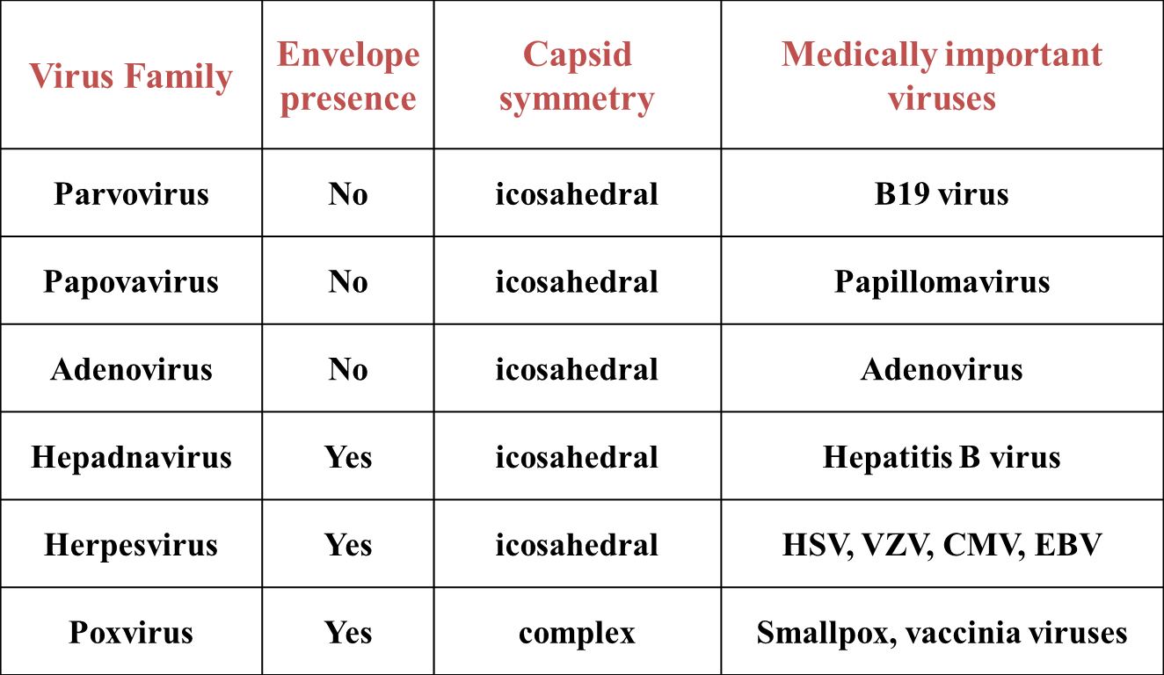
DNA VIRUS

Slide 3
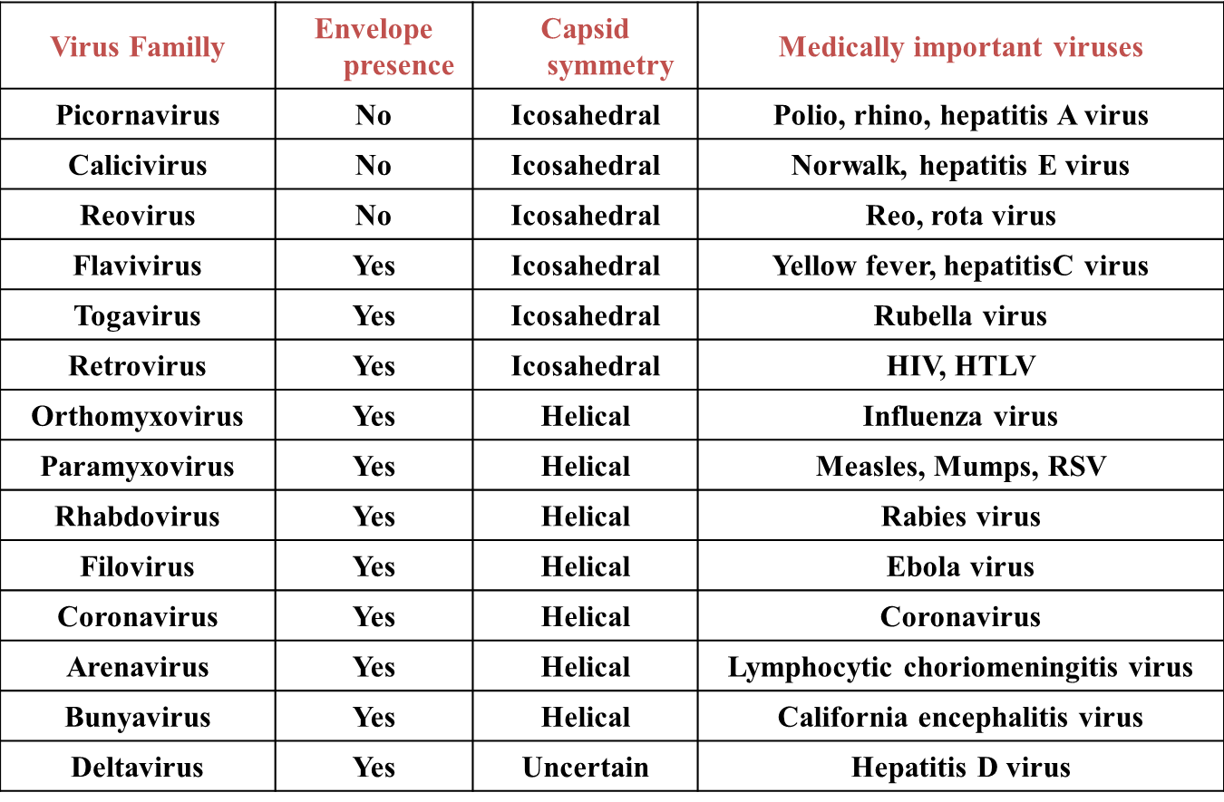
RNA VIRUS

Slide 4
Transmission of viral infection
Viruses are transmitted via horizontal (common route of transmission: person to person), and vertical (mother-to-child transmission) routes or vector transmission (from mosqui- toes, animals;
it can entering the host through a variety of routes, including direct inoculation as well as respiratory, conjunctival, gastrointestinal, and genitourinary routes or break in the skin or via mucosal surfaces of various routes such as respiratory, gastrointestinal, and genitourinary tracts.
Mother-to-child transmission (vertical transmission) can occur in utero, during delivery (via birth canal), and through breast-feeding.
Zoonotic (animal-to-human) transmission by the bite of animals (eg, rabies) or insects (eg, dengue, yellow fever, West Nile) or from inhalation of animal excreta

Slide 5
HSV-1Viruses
DNA Enveloped Viruses
Herpesviruses (HHVs 1 to 8)
The genome is linear double stranded DNA
1) Gingivostomatitis, (also in the primary infection may cause tonsillitis and pharyngitis)
2) Recurrent herpes labialis (cold sore) usually mild lesion.
3) Keratoconjunctivitis: if the primary infection in the eye there will be severe kerato-conjunctivitis, and recurrent lesion is common and may cause corneal ulcer.
4) Encephalitis (Fatal) HSV-1 is considered to be the most common cause of sporadic encephalitis.

Slide 6
HSV-2 causes:
1)Genital herpes
2)Neonatal herpes
3)Aseptic meningitis.
HSV-1 becomes latent in the trigeminal ganglia;
HSV-2 becomes latent in the lumber and sacral ganglia.
Varicella-Zoster virus (VZV)
Varicella :A papulovesicular rash then appear in crops on the trunk then spread to the head and extremities.
Zoster (Shingles): It is the recurrent form, occurs as painful vesicles along the course of the sensory nerve in the head or trunk

Slide 7
Cytomegalovirus CMV
1-Cytomegalic inclusion disease in neonates like intrauterine growth retardation, microcephally, deafness, retinitis, jaundice, hepatosplenomegally, thrombocytopenia.
2) Pneumonia and other systemic diseases in immunocompromised persons
3) Heterophil-negative mononucleosis in normal persons.
Epstein-Barr Virus EBV
1. Infectious mononucleosis (fever, sore throat, lymphadenopathy and splenomegally)
2. Oral hairy leukoplakia (wart-like growth on the tongue in patients with HIV and transplantation.
3. Associated with Burkitt's lymphoma (tumor in the jaw in African children)
4. Nasopharyngeal carcinoma: Cancer of epithelial cells common in males of Chinese origin.
5. Lymphoproliferative diseases (immuno-deficient hosts): like B cell lymphomas.

Slide 8
Poxviruses
Smallpox Virus:Appears with fever, and malaise then severe rash on the face then whole the body.
Vaccinia virus :It is used as a live attenuated vaccine for pox virus vaccination
Molluscum contagiosum virus
It causes small pink papular wartlike benign tumors on skin and mucous membrane, it is mostly transmitted sexually.

Slide 9
RSV (Respiratory Syncytial Virus)
Signs and Symptoms
1-Most common manifestation is febrile rhinitis and/or 2-2-pharyngitisVirus multiplies in mucous membranes of the nose and throat
Mumps
Swollen, painful salivary glands on one or both sides of the face
Pain with chewing or swallowing, especially sour foods or beverages that promote saliva production
Fever
Weakness and fatigue
Tenderness and swelling of a testicle (orchitis)

Slide 10
Measles
highly contagious, characterized by a fever, cough, conjunctivitis (redness and irritation in membranes of the eyes), and spreading rash.
Symptoms
tiny white spots inside the mouth (called Koplik's spots)
photophobia (light sensitivity)
Rash, appears around the fifth day of the disease
Rash may last 4 to 7 days
The rash usually starts on the head and spreads to other areas, progressing downward

Slide 11
Influenza
Signs and symptoms
Fever, sore throat, nonproductive cough, myalgia, headache, and malaise
Lasts 3-7 days
Hepatitis A
Preicteric phase: malaise, anorexia, nausea, and lethargy aren’t as bad, don’t last as long
Icteric phase: Hepatomegaly may produce pain in the right upper abdominal quadrant, followed by bilirubinuria, then pale feces and jaundice.
Convalescent phase: signs and symptoms decrease, virus is eliminated from body.

Slide 12
Human Papillomavirus (HPV)
Papillimas (warts) ; condylomata acuminata (genital warts ) associated with carcinoma of the cervix and penis.
Parvovirus B19
If women is infected withB19 virus during the1st trimester is lead to fetal death, whereas infection during the2nd trimester lead to hydrops fetalis
Arthritis:-the virus when infect women can cause arthritis ressemble rhematoid arthritis

