Slide 1
Culture and Media
By
Dr. Hesnaa Saeed Al-Mossawi

Slide 2
culture
Culture is the term given to microorganisms that are cultivated in the lab for the purpose of studying them.
Medium is the term given to the combination of ingredients that will support the growth
The ability of microorganism to use a particular compounds is dependent upon the genetic makeup (DNA) that the cells have.
Culture media may be found in one of three states:
liquid (called broth)
semi-solid
solid.

Slide 3
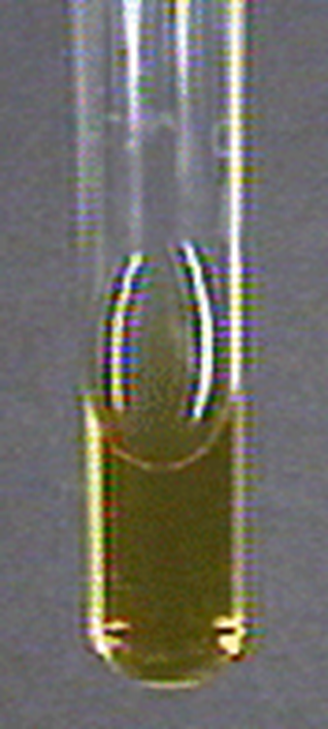
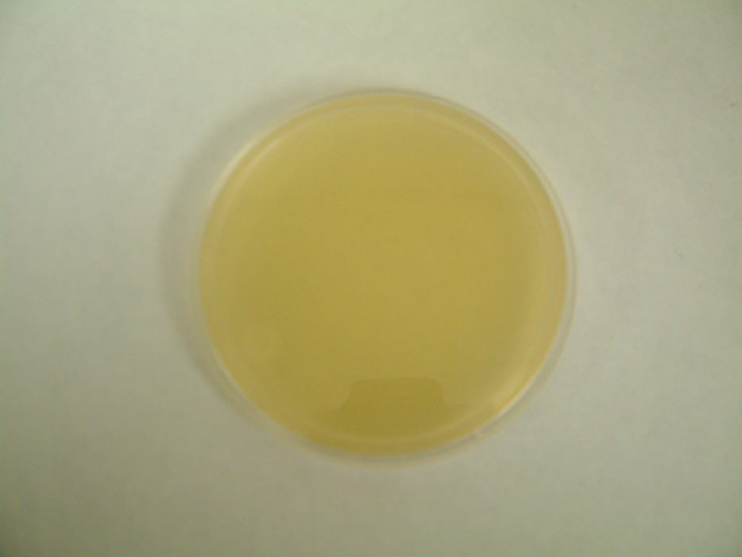
SIMPLE MEDIA
Simple or basal media are culture media which contain the minimum adequate nutrition for non fastidious organisms
Uses:-
This is basis of most of the media used in the study at common pathogenic bacteria.
It is used for subcultures of certain organisms.
NUTRIENT AGAR
NUTRIENT broth

Slide 4
COMPLEX MEDIA
Complex media have added ingredients for bringing out certain properties or providing special nutrients required for growth of the bacterium
When basal medium is added with some nutrients such as blood, serum or egg is called enriched media.
They are used to grow bacteria which are more exacting in their nutritional needs.
Special MEDIA

Slide 5
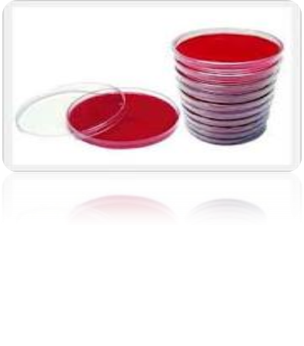
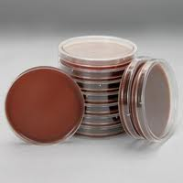
BLOOD AGAR
TYPE : Enriched media.
APPEARANCE : Red color.
COMPOSITION : Nutrient agar + Defibrinated sheep blood
USES :
Routine culture
It is also an indicator medium showing the haemolytic properties of bacteria
CHOCOLATE AGAR
Also called Heated blood agar.
TYPE : Enriched media.
APPEARANCE : Chocolate brown color.
PROCEDURE : Melt the desired amount of nutrient agar.
Cool it in a water – bath at 75º C . Add 10 ml of sterile blood .
Mixing the blood and agar by gentle agitation from time to time until the blood become chocolate brown in color

Slide 6
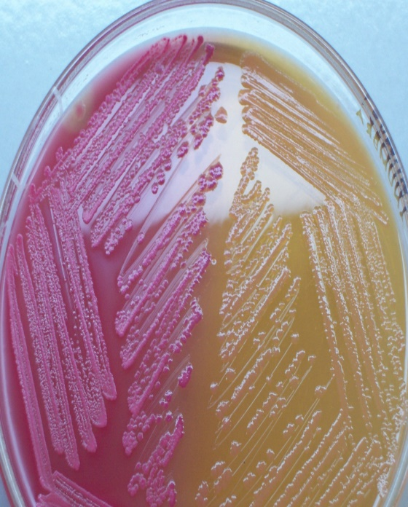
ENRICHMENT MEDIA
In this media, it has a stimulating effect on the bacteria to be grown or inhibits its competitors.
This result in an absolute increase in the number of wanted bacteria related to other bacteria.
Example:- Selenite F broth
It is enrichment medium for culture of Salmonella typhi and paratyphi bacilli from stool sample
MacConkey agar is a culture medium designed to
grow Gram-negative bacteria. It is a useful medium for the
cultivation of Enterobacteriaceae
MacConkey agar showing both lactose and
non-lactose fermenting colonies.
Lactose fermenting colonies are pink whereas
non-lactose fermenting ones are colourless.
Differential MEDIA

Slide 7
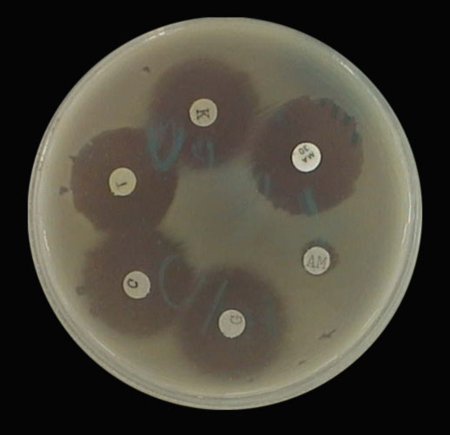
Mueller-Hinton agar
is an microbiological growth medium that is commonly used for antibiotic susceptibility testing.
Originally formulated for isolation of Neisseria species.
It is also used to isolate and maintain Neisseria and Moraxella species.

